Slide 1


Practical Training Presentation
AI ENABLED B2B FINANCE INVOICE MANAGEMENT APPLICATION
Let’s Go

Slide 2


Sachin Yadav
Presented By
Dr. Hitesh
Mohapatra
Assistant Professor at KIIT University, Ph.D. in Computer Science and Engineering
Aspiring Data Scientist, AI/ML Engineer, Final Year Student at KIIT University
20051751
hiteshmahapatra.fcs@kiit.ac.in
Presented To
Notes:
Photo by Joseph Gonzalez on Unsplash

Slide 3
Introduction and Objectives
Automate Data Extraction: To automate the extraction of relevant
Data from invoices using AI technologies and reducing manual data entry efforts.
Invoice management is a critical aspect of any business’s financial operations. AI enabled B2B is an advanced software solutions that leverages the power of AI to streamline and optimize the entire invoicing workflow for the B2B transactions.
Streamline Invoice Processing: To optimize the end-to-end invoice processing workflow, minimizing delays and errors in approvals and payments.
Enhance Accuracy and Efficiency: To improve the accuracy of data processing and reduce human errors, leading to more efficient and reliable invoice management.
Optimize the Cash Flow Management: To expedite invoice processing, improving cash flow management and financial planning for businesses.

Slide 4
The Problem/Challenge
Inefficiency
Statistics
Challenges
1
2
3
Time Consuming and Labour – Intensive Process
Cash Flow Disruptions
Incur processing costs that are 1.5 to 2.5 higher compared to AI enabled
Lack of Visibility and Tracking
Increased Dispute Resolution Efforts
70% processing time reduced results in faster payments and improved supplier relations.
Higher Operational Cost
Reduced Productivity
47% of business struggle with a lack of visibility into the invoice approval
Team

Slide 5
Solution Approach
Analytics Approach
AI/ML Approach
By leveraging cutting-edge technologies such as OCR and NLP, the application automates data extraction from invoices, eliminating errors and saving valuable time. Additionally, AI algorithms verify invoice authenticity, reducing the risk of fraudulent activities and streamlining the approval process with intelligent routing workflows.
Real-time visibility into invoice statuses and interactive reporting empower finance teams to monitor spending trends and improve decision-making. The application's seamless integration with existing systems ensures a smooth transition, while robust security measures protect sensitive financial data.
Team

Slide 6
Project Requirement Specifications(PRS)
ML Model Requirements
1.View Invoice Data from buyers
2.Perform Data preprocessing on the invoice data
3.Get Analytics
4.Get a prediction when invoice is going to get paid.
ML model with best accuracy score i.e r-squared score without overfitting of data is acceptable.
ML model should not have been trained using data leakage.
Feature Engineering is a most required section.
UI Design Requirements
To Build a full stack Invoice management application using react.js
Build a responsive receivables dashboard
Visualize data in the form of grids
Visualize data in the form of graphs
5. JDBC, Java, Servlets
6. Perform Searching operations on the invoices.
7. Add and Edit data in the editable fields of grid
8. Delete data of selected rows
9. Predict Button and Refresh button

Slide 7
Requirement Specifications
1.Data Loading in DB:
The invoices dataset needs to be parsed, processed and loaded in the MySQL database workbench
2.UI Representation of the data:
Build a responsive Ui that can display invoice data from DB.
UI Should support searching and pagination
Ui Should support edit, add, delete and advance search
3. AI support in the application:
Add support for predicting the payment amount for one or more invoices
UI should have a button to trigger the prediction of the amount.
4. System Design:
Creation of UI(User Interface)
Grid Creation
Grid Data Loading
Performing crud operations

Slide 8

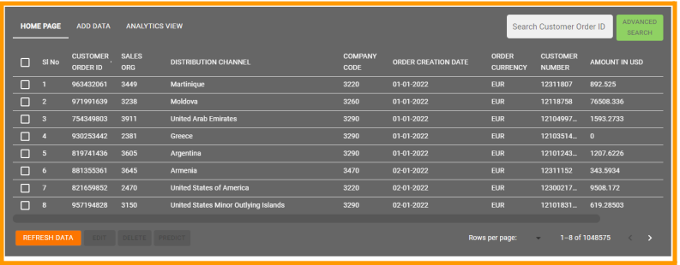
Homepage
80%
Notes:
<a href="https://storyset.com/design">Design illustrations by Storyset</a>

Slide 9

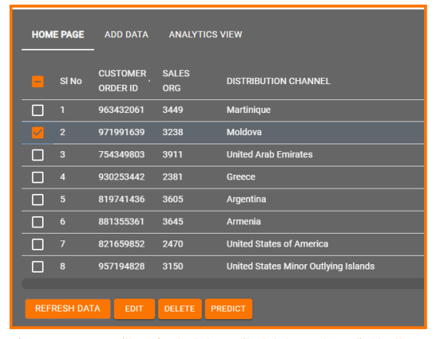




Buttons For the UI
80%
Refresh the Invoice data
Edit the selected rows invoice data
Delete the selected row invoice data from database
Predict the amount to be order which has initial 0 amount
Notes:
<a href="https://storyset.com/design">Design illustrations by Storyset</a>

Slide 10

Edit and Delete Dialog Box
80%
Notes:
<a href="https://storyset.com/design">Design illustrations by Storyset</a>

Slide 11
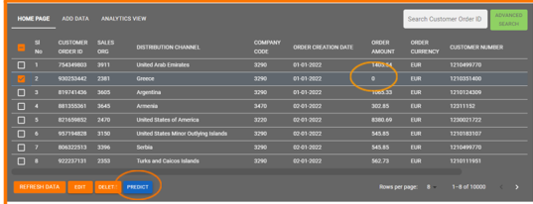
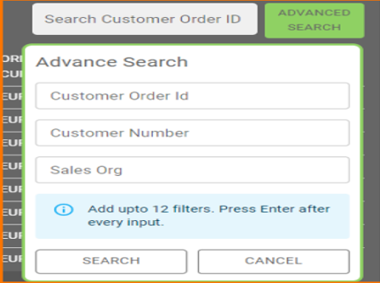
Prediction, Pagination, Advance Search UI
Prediction
Pagination
Advance search
40%
80%
75%
Notes:
<a href="https://storyset.com/design">Design illustrations by Storyset</a>

Slide 12
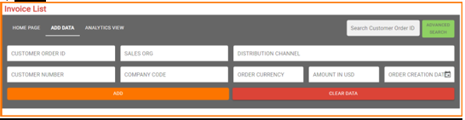
Analytics View, Search Result, Add Data
Analytics View
Search Result
Add Data
75%
80%
40%
Notes:
<a href="https://storyset.com/design">Design illustrations by Storyset</a>

Slide 13
Tech Stack
Backend
UI/Frontend
AI/ML
1
2
3
ML model creation for prediction of order amount
MySQL database for storing data and Java Database Connectivity to create server for real time management
Responsive and Interactive UI creation
Efficient Model for the flawless operation of the application
React.js and Material UI for the elegant UI creation
Java Servlets for API creation
Regression, Decision Tree, Random Forest, SVM, XGBoost, Deep Learning Models
Crud Operations and POJO
Homepage, Add Data, Analytics view, search , Advanced Search, Data Grid, Predict , Edit , Refresh
Project

Slide 14
Implementation/Flow Diagram
Stages of implementing AI enabled finance B2B Invoice Management Application
ML Model
ML model was trained using xgboost model
Loading data into MySQL Yog
Data was loaded into the Yog and queried
JDBC Connection
Java Database Connectivity were made
Creation of Template
In eclipse the template for data and methods were created
Finish
UI Creation
Using React.js Ui was created according to PRS
Integration of ML model to predict Amount
At last stage everything were integrated
Java Servlets
APIs for all functionalities like edit, delete, read, insert
Notes:
<a href="https://storyset.com/design">Design illustrations by Storyset</a>

Slide 15
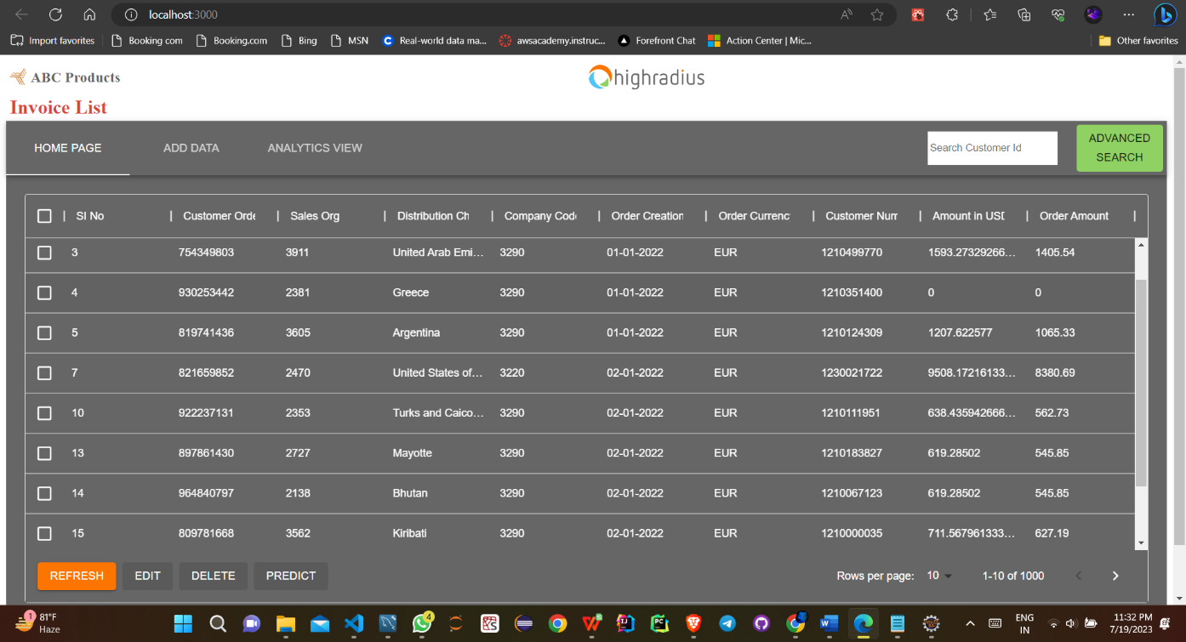
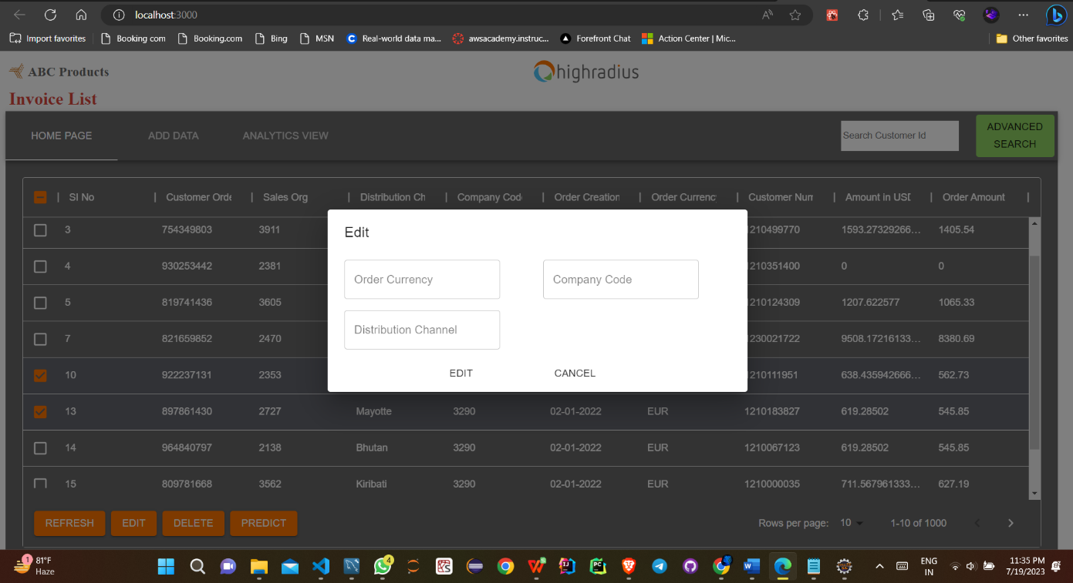
Implementation Output

Slide 16
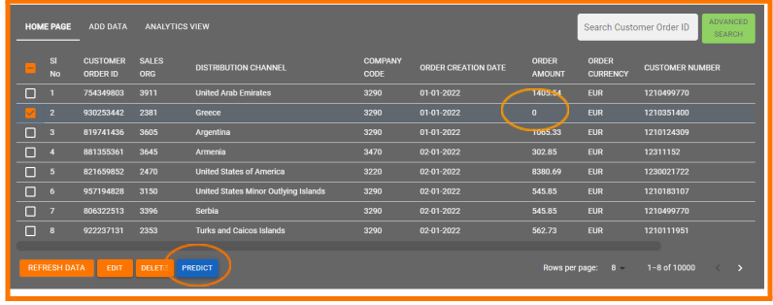
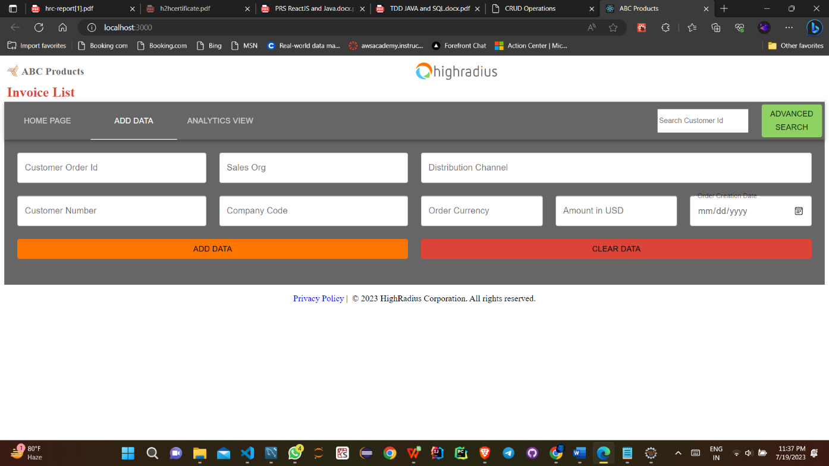
Implementation Output

Slide 17
Key Findings
Significant Time and Cost Savings: The application's automated data extraction and streamlined workflows lead to substantial time savings for finance teams. Businesses also benefit from cost reductions due to decreased manual labor and improved efficiency in invoice processing.
Faster Invoice Approvals: The intelligent routing workflows and automated approval processes expedite the entire invoice lifecycle. This leads to faster approval cycles, improved vendor relationships, and enhanced overall operational efficiency.
1
2
Order Amount Prediction Model with Interactive Ui
Enhanced Accuracy and Reduced Errors: The use of AI algorithms for data extraction and invoice verification significantly reduces human errors, ensuring greater accuracy in financial data. This minimizes the risk of processing incorrect invoices and potential financial losses.
User-Friendly Interface and Training: The application's intuitive user interface requires minimal training, allowing users to quickly adapt to the system. This reduces the learning curve and enhances user satisfaction.
4
3

Slide 18
Future Scope
NLP for Vendor Communication
Smart Contract Integration
Automated Communication with vendors
Automate payment processes, ensuring security
Enabling faster query resolutions and improving collaborations
Timely payments if predefined conditions are met
Expense Management Integration
Global Expansion
Expanding the application's scope to include expense management features would provide a comprehensive financial management solution for businesses.
Expanding the application's capabilities to support multi-currency transactions and compliance with various international tax regulations would attract a broader global customer base.
Notes:
<a href="https://storyset.com/design">Design illustrations by Storyset</a>

Slide 19
Conclusion
Synopsis
1. Automation for Efficiency: The AI-enabled application automates data extraction and verification, reducing manual effort and increasing operational efficiency.
2. Predictive Insights for Informed Decisions: Leveraging predictive analytics, businesses gain valuable insights to optimize cash flow and make data-driven financial decisions.
3. Fraud Prevention and Data Security: The application's smart verification ensures fraud prevention, safeguarding financial data with robust security measures.
4.Cost Savings and Accuracy: Streamlined approval cycles and reduced errors lead to significant cost savings and enhanced accuracy in invoice management.
5. User-Friendly and Scalable: With seamless integration and a user-friendly interface, businesses of all sizes can adopt the application for sustainable growth and financial success.
The AI-enabled B2B finance invoice management application revolutionizes financial operations with automation, predictive analytics, and fraud prevention, leading to cost savings and enhanced accuracy. Seamlessly integrated and user-friendly, it empowers businesses for a more productive and profitable future.

Slide 20


Thanks for being patience listener
Thank you for your time and attention. If you have any questions or would like to explore the application further, please feel free to reach out.
Notes:
<a href="https://storyset.com/design">Design illustrations by Storyset</a>

